Slide 1
Netflix Movies and TV Shows Clustering

Slide 2
We sincerely appreciate the opportunity to analyse Netflix movies and TV shows based on various features like genre, rating, and duration. And also develop a machine learning model that can identify similar content groups, which can help users discover content based on preferences.
Our analysis will include insights into Movies and TV shows trends and deliver a clustering model that can can identify similar content groups.

Slide 3

EDA Analysis

Slide 4
Data Preprocessing
Downloaded the dataset from the provided link, extracted it, and read it into a DataFrame.
Started data preprocessing by checking for null or empty values and applied imputation where necessary.
Performed value counts on each feature to detect missing or unusual data entries.
Identified and handled unknown or inconsistent values within columns to clean the dataset.
Determined the encoding technique for to convert text to number format.
Reformatted columns to ensure consistency and followed a uniform pattern.
Applied normalization and standardization to scale the selected columns appropriately.

Slide 5
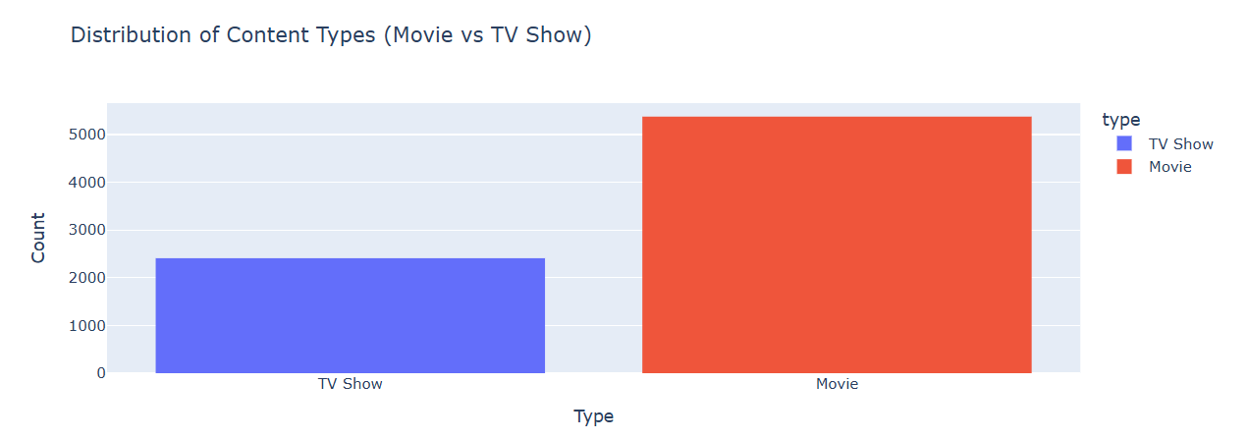
Movies have a significantly higher count than TV Shows — over 5,000 titles, compared to approximately 2,400 TV Shows. Ratio: Roughly 2:1 (Movies: TV Shows).
This suggests the platform prioritizes more movie content than TV shows, either due to: Licensing ease, Lower production cost per title, Viewer preference or platform strategy.
A user opening the app is more likely to be shown a movie, simply due to volume. However, TV show watchers may be more engaged over time (multiple episodes), so quantity doesn’t always mean better retention.
TV-Show expansion: Target emerging market where serialized content is preferred. Focus on regional or original series, especially if competing platforms (like Disney+ or HBO Max) dominate in that segment.
Movie enhancement: Select more genre-specific movie clusters Emphasize top-rated or trending movies using cluster plus rating combos.

Slide 6
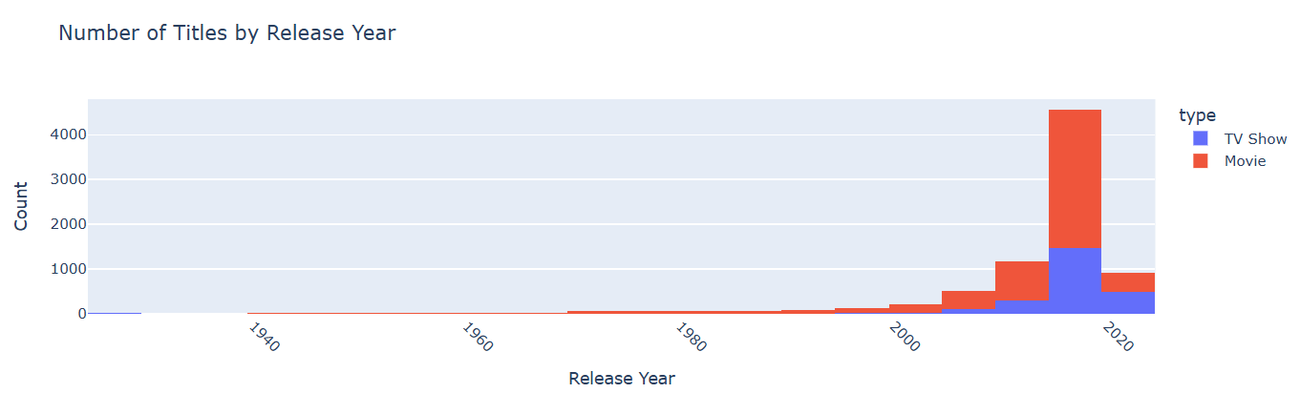
The peak in content releases occurred between 2017 and 2019. This surge is driven primarily by movies (shown in red) but also includes a noticeable rise in TV shows. Suggests Netflix ramped up content acquisition and production during this time.
Noticeable There is a drop in title count after 2020, visible in both types. This may be due to COVID-19 pandemic halting productions, Shifts in strategy focus on quality vs quantity, Longer production timelines for new shows/movies post-pandemic.
Minimal titles from earlier decades, especially pre-2000. Indicates Netflix focuses more on modern content (less classic/archival material), Possibly reflects licensing limitations for older titles.
From around 2015 onwards, TV show production has steadily grown.TV Shows (blue) account for a larger proportion of new titles post-2016 than in earlier periods.

Slide 7
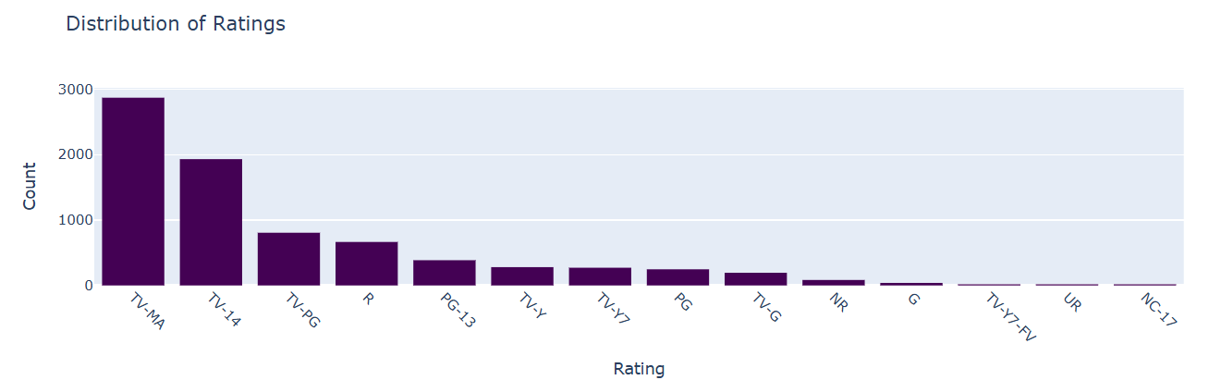
TV-MA is the most frequent rating, with nearly 3,000 titles. This rating includes content with strong language, violence, or other content. Suggests that a large portion of Netflix’s catalog targets adult viewers.
TV-14 is suitable for viewers age 14 and up. Also widely represented with nearly 2000 titles. A significant portion of content is teen-friendly, capturing a younger demographic. May include teen dramas, action shows, and some comedies.
Ratings like TV-Y, TV-G, TV-Y7, PG, G all appear with much smaller counts. Even PG-13, PG, and TV-PG are lower compared to mature ratings.
Strategic Takeaways Netflix targets a mature, global audience, with emphasis on thrillers, dramas, action, and adult themes.

Slide 8
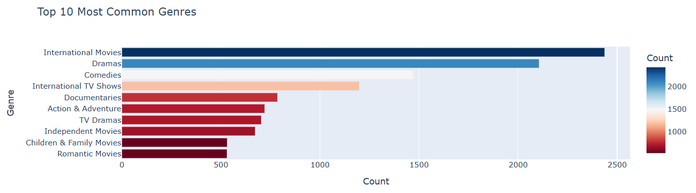
International Movies are the most common genre, with over 2400 titles. Netflix has heavily invested in global content, reflecting its international expansion strategy. Includes films in non-English languages (e.g., Indian, Korean, Spanish, French).
Dramas come second, with ~2200 titles. Dramas offer deep engagement, emotional storylines, and wide appeal across ages and cultures.
International TV Show With ~1200 titles, Likely includes hit series from Korea (Squid Game), India, Brazil, Spain (Money Heist), etc.
Independent Movies, Children & Family Movies, Romantic Movies rank lower in count. Netflix offers some variety in niche and family content, but they are not the focus.
Netflix’s content library is genre-diverse but clearly prioritizes International titles, Dramatic storytelling, Mass-appeal comedy, With growing support for non-fiction, action, and global TV.

Slide 9
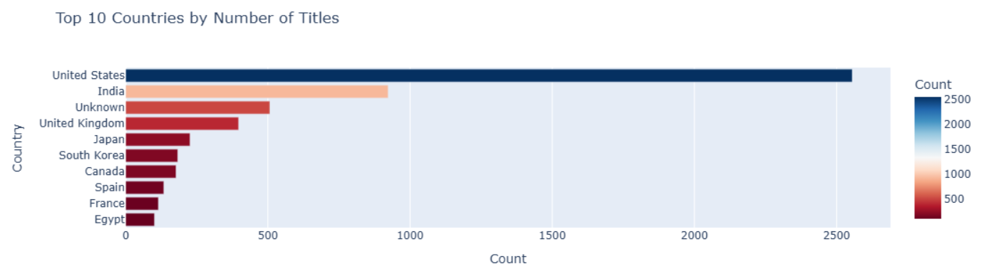
US With ~2600 titles, the United States leads by a large margin. Far ahead of other countries, nearly 3× more content than the second-ranked(India). Reflects Netflix's roots in the U.S. and its massive Hollywood content catalog. Indicates Netflix still heavily relies on Western and English-language content.
India contributes close to 900–1000 titles. Includes a mix of Bollywood movies, regional-language films, and Indian TV/web series. India is a priority market for Netflix.
Japan and South Korea these countries are major exporters of anime, K-dramas, and local films. Reflects Netflix’s deliberate push into Asian entertainment. Korean content has seen global success. Japan is a leader in anime.
Spain and France provide critically acclaimed cinema and series. Egypt rounds out the top 10 with a few hundred titles. Represents Netflix’s investment in Arabic-language content for the Middle East and North Africa (MENA) region.

Slide 10

Model Selection

Slide 11
Model Selection
Selected the relevant input (feature) columns for to perform clustering Netflix movies and TV shows based on various features like genre, rating, and duration.
Preprocess Numeric Columns Use standardization or normalization to bring features to a common scale.
Preprocess Text Columns two main options depending on use case Vectorization or Category Encoding.
Dimensionality Reduction apply PCA to reduce feature space especially if text vectorization adds many dimensions. Useful for visualization and faster clustering.
Apply Unsupervised Learning Algorithm based on the task K-Means, DBSCAN, Hierarchical Clustering for clustering.
Evaluate and Interpret Result by Using metrics Silhouette Score, Davies Bouldin Index, or Elbow Method (for clustering) . Use visualization 2D/3D scatter plots.
Save and Reuse the Model by Saving preprocessing pipelines and model using pickle file.

Slide 12
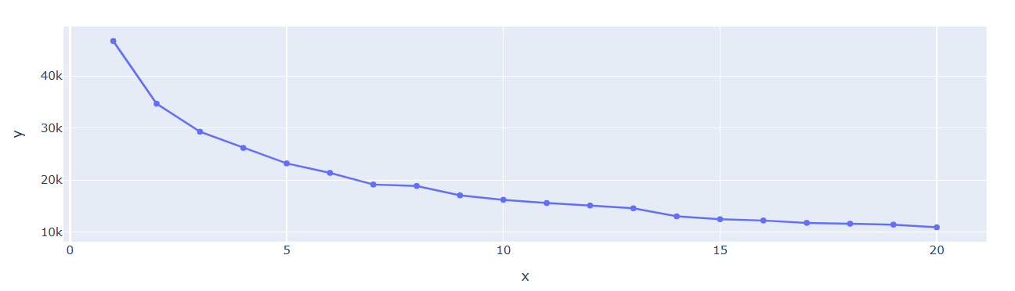
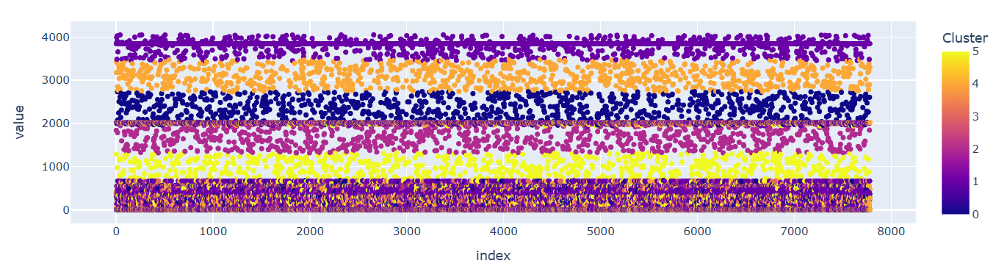
K-Mean Clustering Model
Apply Elbow method to find the K value.
The WCSS drops steeply from K=1 to around K=5-6.
After that the curve bends and starts to flatten.
So I have chosen the K value as 6 and built the model.
Plotted the clustering using scatter plot.

Slide 13
K-Mean Clustering Model
Cluster 0 - Solidly performing shows/movies. Consistent popularity or critical reception.
Cluster 1 - Very high value, possibly indicating high feature score. Could include legacy classics, high critic scores but low recent popularity, or a mix of standout attributes.
Cluster 2 - Slightly below “Top Rated” but above mid-tier. Could be genre specific hits or well reviewed content that isn’t broadly known.
Cluster 3 - Lowest value, possibly low rating or popularity. Could represent unpopular, niche, or new/unrated content.
Cluster 4 - High popularity or ratings. Potentially trending, blockbuster, or highly rated content.
Cluster 5 -Mid-range content in terms of ratings/popularity. Possibly under-the-radar or emerging content.

Slide 14
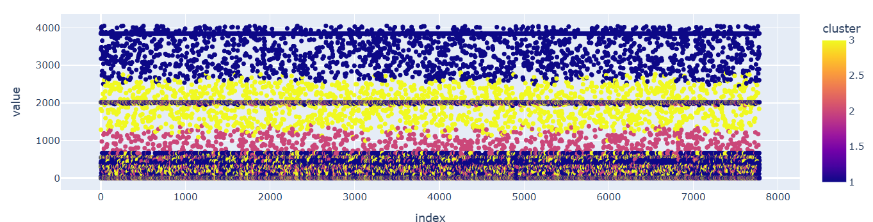
Hierarchical clustering Model
Create linkage matrix using Ward's method.
Plot Dendrogram the dendrogram helps decide how many clusters to form by visually cutting the tree.
Assign cluster labels. The largest height jump appears at the top 2 merges.
If you draw a horizontal line slightly below the tallest merge. It will intersect 3 vertical lines, meaning 3 clusters.
Plotted the clustering using scatter plot.

Slide 15
Thank you
Avinache. M
GUVI Team
Data Analyst

